Slide 1
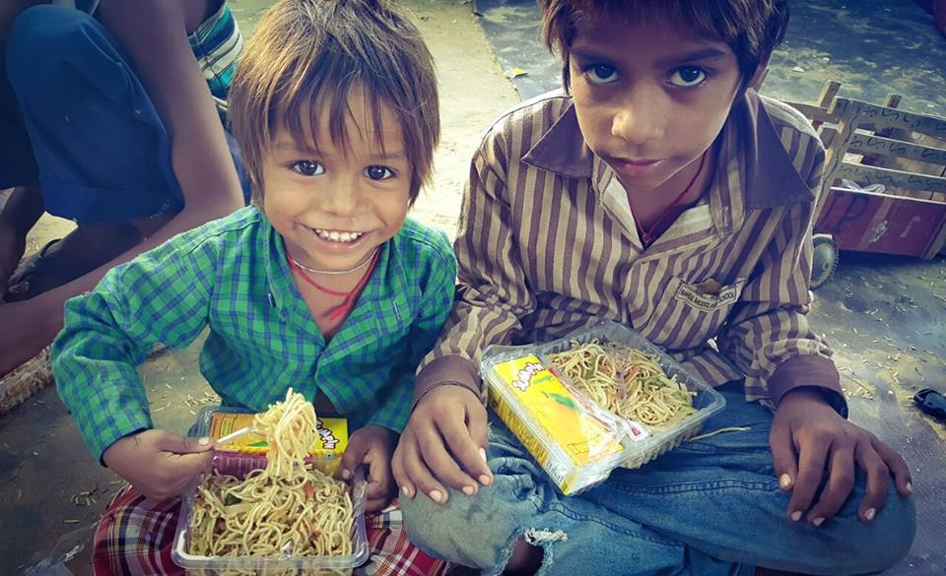
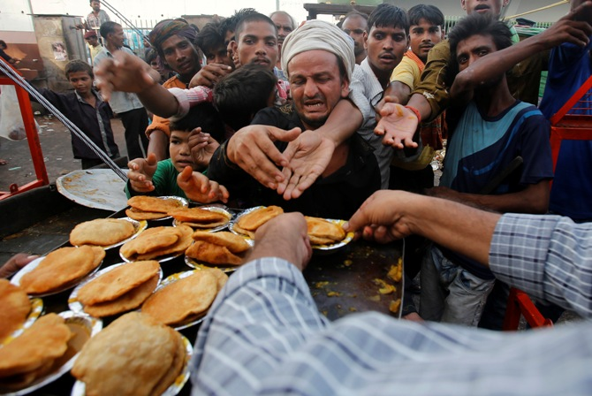
FOOD LOCATOR
LETS REMOVE HUNGER

Slide 2

TECH CODERS
ABHILASHA RANI
AKANKSHA
ASTHA ANAND
GARIMA MISHRA
PRACHI PRIYA

Slide 3
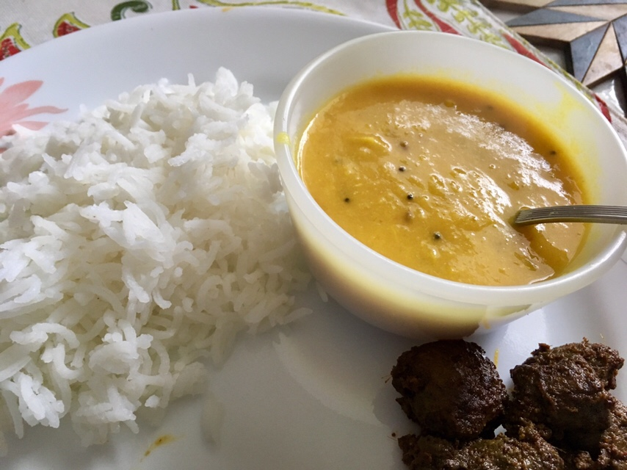
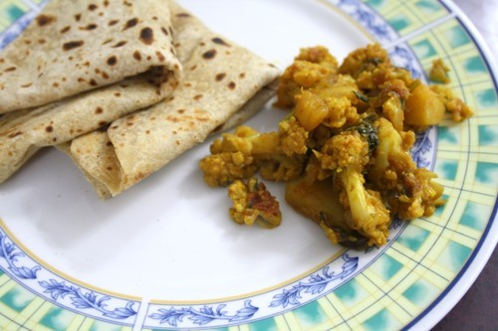
INTRODUCTION
Food is the third most essential thing for life after air and water. A person cannot survive without food for more than few weeks. This shows importance of food for life.
Some people eat due to taste factor of the food. Taste preferences are automatically set from birth.

Slide 4
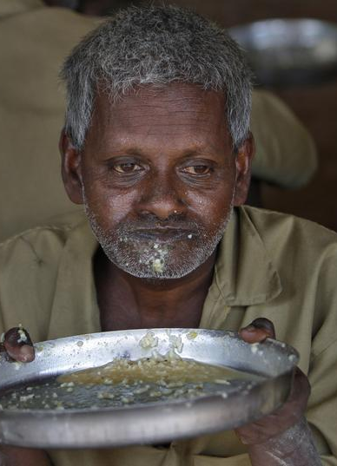
BUT THINGS ARE DIFFERENT FOR SOME GROUP OF PEOPLE
Some people do not even get food to fulfill their body needs.
Such people do not have enough money to buy food.
They just depends on others who give them food to fulfill their body needs.

Slide 5


WHAT WE WANT TO DO ?
We want to help such kind of person who didn’t get food or depend on others for the food.
We can help them manually, by go to their place and give them food but it is not efficient way.
We can help them by the use of technology. As we know humans cannot reach everywhere but machine can.

Slide 6

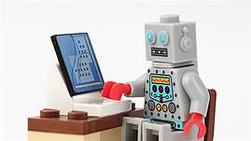

HOW CAN WE HELP THEM?
We can help them with chat-bot for what they need.
A chatbot is a software application used to conduct an on-line chat in lieu of providing direct contact with a live human.
This will come in handy for asking them for their needs.

Slide 7

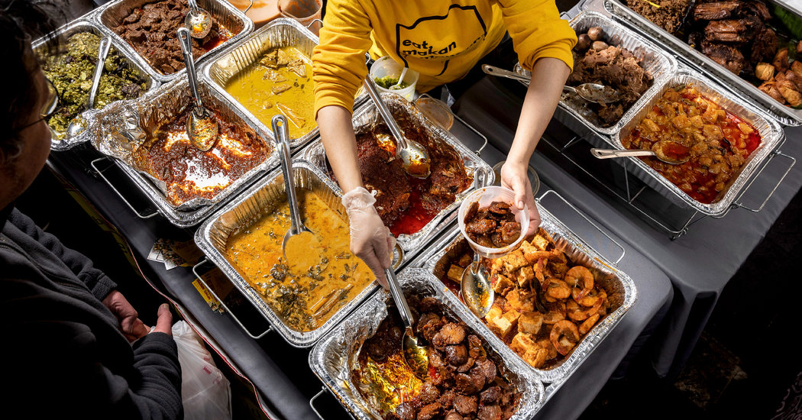
PROPOSED SOLUTION
There is a need for an application through which the needy people can easily ask for food and get their food easily.
All the states will have their own server which will be connected to various NGOs, government organizations, hotels.
When person asks for food, the application will hit the server, the server will start finding available supplier.

Slide 8

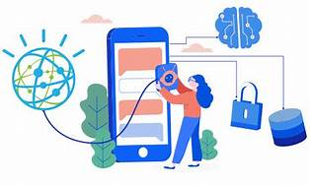
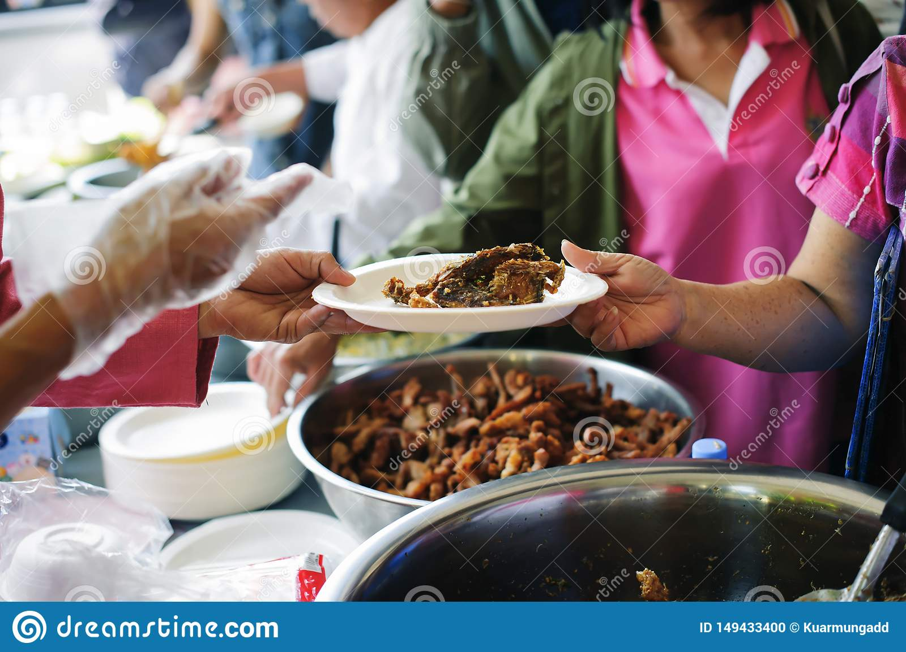
PROPOSED MODEL
END USER ASK FOR FOOD
CONTACT TO SERVER
FINALLY THEY GOT FOOD

Slide 9


FUTURE SCOPE
The registration option of those who provide food for the needy person for getting notifications whenever someone asks for food.
On scaling up we will add different languages to it.
A separate column for money donation. As some people want to donate money for the food of these needy persons.

Slide 10
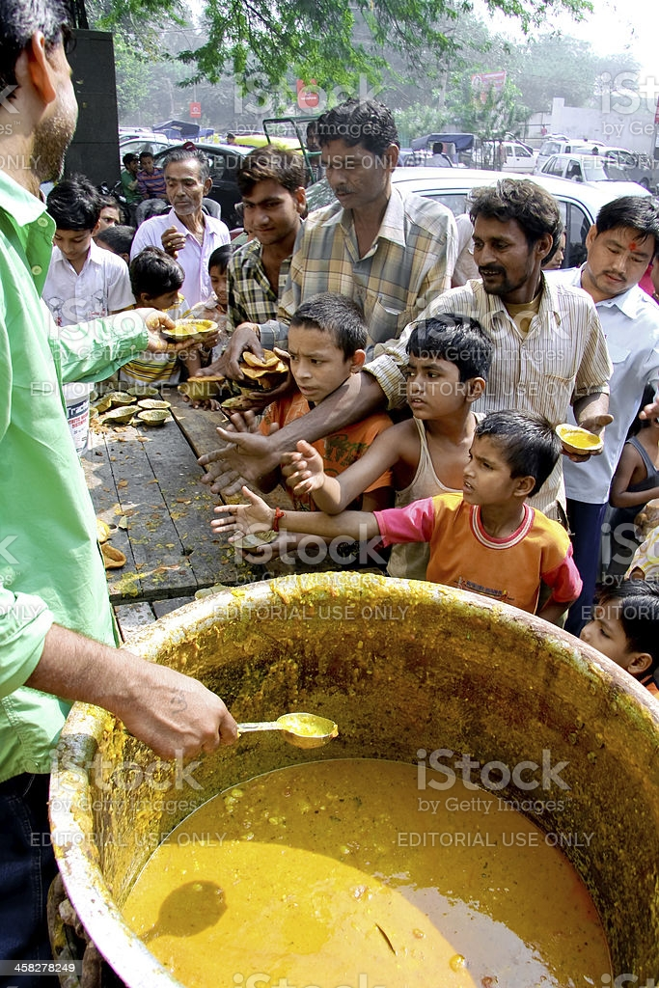
CONCLUSION
This application of ours is a small effort that we can help them by providing food to them.
We know that this will not completely eliminate this problem, but it will definitely reduce it.
After implementing this, many people start getting food. No one will go to bed without eating.

Slide 11

THANK YOU

